Slide 1
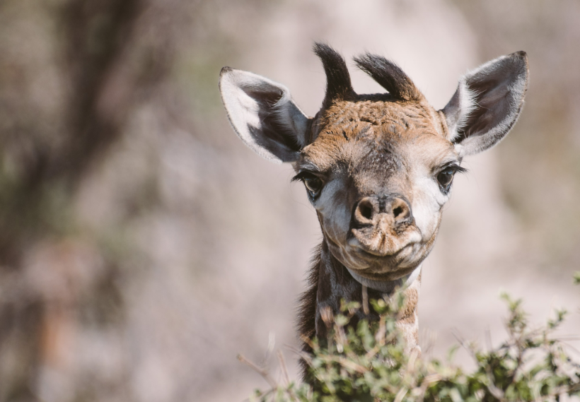
REVOLUTIONIZING WILDLIFE CONSERVATION: ANIMAL TRACKING WITH IOT
BRIDGING THE GAP BETWEEN TECHNOLOGY AND WILDLIFE
https://thetravelblog.at/wildlife-photography-nikon-z-6/

Slide 2
AGENDAS
Introduction
Objectives
Data acquisition
Data transmission methods
Data processing and management
Data analytics and visualization

Slide 3
INTRODUCTION
Conflict between humans and animals.
An IoT-driven solution that fosters a sense of harmony

Slide 4
OBJECTIVES
Behavioural insight
Conflict Zone Mapping

Slide 5
DATA ACQUISITION
Visual Insights with Camera
HD night vision cameras
Auditory Data for Enhanced Understanding
Precision Tracking with Motion Sensors
Revolutionizing Wildlife Monitoring through IoT Data Acquisition.

Slide 6
CAMERA
Video capture with Orange Pi.
Night vision HD cameras.
Extract each frame from the video.
Send frame to AI model to spot animals

Slide 7
MICROPHONE
Detect animal sounds.
Pre trained AI models.
Sent to server for processing.

Slide 8
MOTION SENSORS
Capture motion data using PIR sensor.
Triggers due to animal movement.
Processed within the same edge device
Processed data sent to server.

Slide 9
DATA TRANSMISSION METHODS
Connectivity via 4G Network
MQTT Protocol for Efficient Communication
IoT-Powered Data Transmission Unveiling the Secrets of Nature

Slide 10
WHY 4G CONNECTIVITY?
High Data Transfer Rates
Widespread Coverage
1

Slide 11
WHY MQTT PROTOCOL?
1
Light weight efficient protocol
Ensures data transmission reliability

Slide 12
TRANSMITTING INFORMATION
INFORMATION OBTAINED
1
Timestamp
Animal location
Animal category
Animal count

Slide 13
DATA PROCESSING AND MANAGEMENT
EDGE COMPUTING
SERVER-SIDE PROCESSING
Orchestrating IoT for Seamless Processing and Management in Wildlife Conservation

Slide 14
EDGE COMPUTING
Efficient On-site Analysis
Reduced Latency
High speed

Slide 15
SERVER SIDE PROCESSING
Data processing
Stored on Relational database
Reporting and alerting

Slide 16
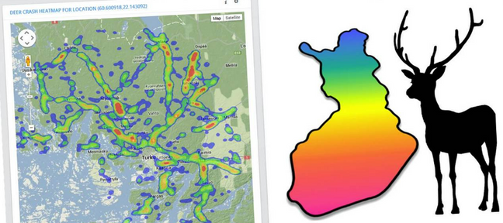
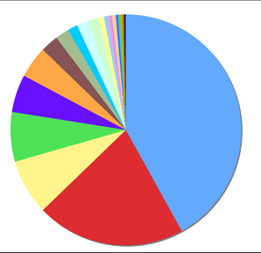
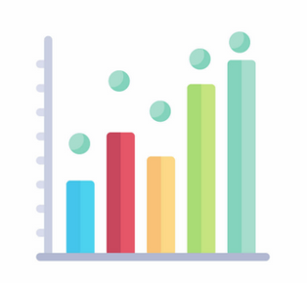
DATA ANALYTICS AND VISUALIZATION
https://blog.internations.org/blog/2011/08/03/give-us-your-opinion-on-internations-events-activities-and-win-a-casio-highspeed-digital-camera/
https://www.vecteezy.com/
HEAT MAP
PIE CHART
BAR GRAPH
Where is animal frequently seen?
In which month is the animal frequently seen?
Animal categorization

Slide 17
DATA ANALYTICS AND VISUALIZATION
Generating alert
Generating reports
Tabular
Graphical

Slide 18
TABULAR REPORT
Showing list of animal appearance
Download and share data

Slide 19
GRAPHICAL REPORT
Heat maps for frequently appeared locations
Pi chart for frequently appeared animals
Bar graphs for most appeared time

Slide 20
CONCLUSION
REFERENCES
https://www.researchgate.net/publication/325635623_Animal_monitoring_based_on_IoT_technologies https://www.geeksforgeeks.org/advantage-and-disadvantage-of-edge-computing/ https://www.4g.co.uk/what-is-4g/
https://mqtt.org/
Study wildlife
Avoid human animal conflicts

